Slide 1



Building with react
By Elham Jaffar

Slide 2

(1) Why react?

Slide 3
react
React is a JavaScript library for building user interfaces. It is maintained by Facebook, Instagram and a community of individual developers and corporations.
Developer(s): Facebook, Instagram and community
License: MIT
Original author(s): Jordan Walke
Initial release: March 2013; 5 years ago
It’s just a JavaScript Code
Notes:
React is only concerned with the View layer of our app

Slide 4
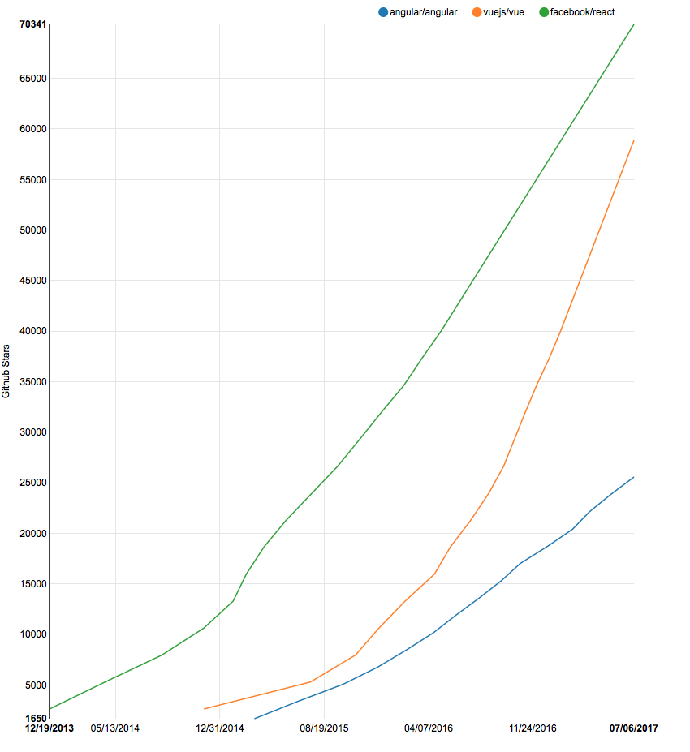
Angular vs react vs vue.js
Notes:
https://medium.com/unicorn-supplies/angular-vs-react-vs-vue-a-2017-comparison-c5c52d620176

Slide 5
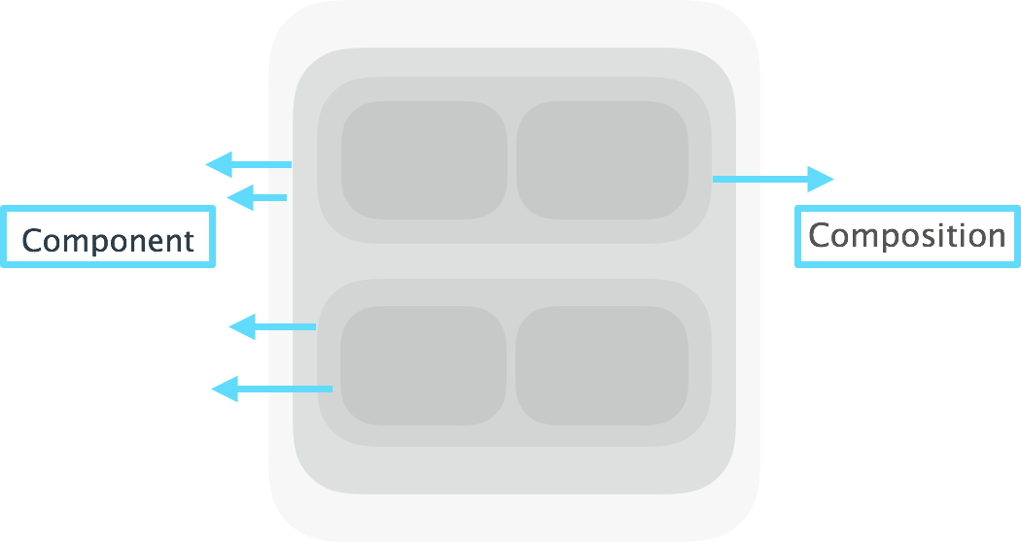
react

Slide 6
Composition
React favors composition over inheritance. There are several useful ways to compose components in React.
Composition is a way to get polymorphic behavior in a way that's often more flexible and easy to work with than is inheritance.
React builds up pieces of a UI using components.
To combine simple functions to build more complicated ones.
Notes:
polymorphic behavior is the characteristic of being able to assign a different meaning or usage to something in different contexts

Slide 7
Imperative vs Declarative
Imperative
Declarative
How?
WHAT ?
Expressing a Command
We tell the code what to do
and how to do it.
Declare what we want and leave
the programming language to
figure out how to produce the,

Slide 8
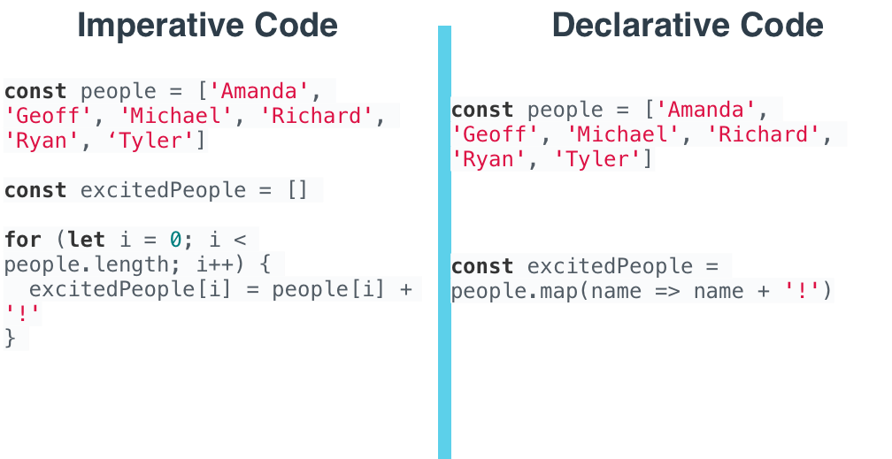
Imperative vs Declarative

Slide 9
React is Declarative
React is declarative because we write the code that we want, and React is in charge of taking our declared code and performing all of the JavaScript/DOM steps to get us to our desired result.

Slide 10
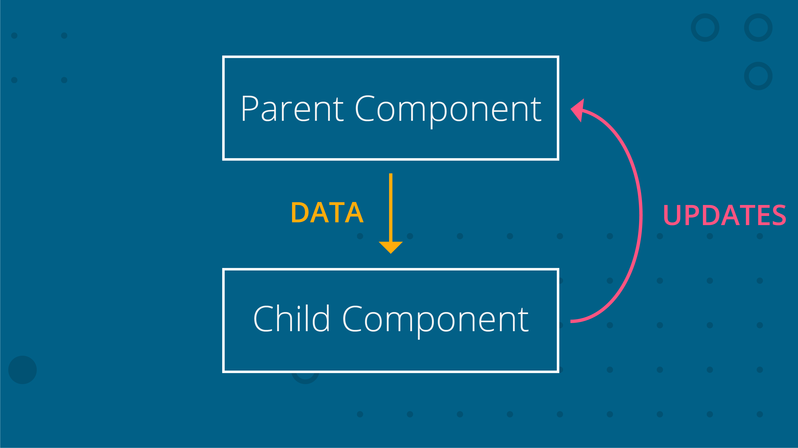
Data-flow
In React, the data flows from the parent component to a child component (One Direction).
Notes:
The change can only be done in parent component. If child wants to update, it sends the data to the parent component.
Having the data flow in one direction and having one place where the data is modified makes it much easier to understand how the application works.

Slide 11
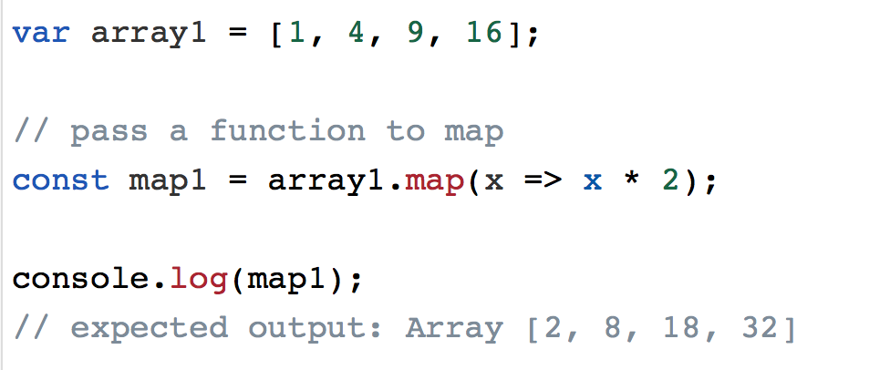
Array methods: Map
The map() method creates a new array with the results of calling a provided function on every element in the calling array.
Notes:
Map second argument is index, it is optional

Slide 12
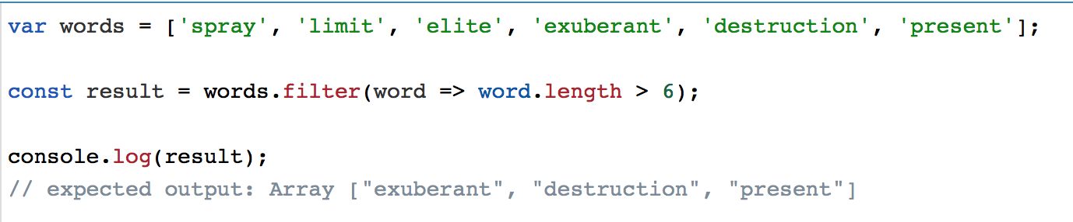
Array methods: Filter
The filter() method creates a new array with all elements that pass the test implemented by the provided function.

Slide 13
Combining Map() & Filter () exercise
const people = [
{ name: ‘Khalid’, age: 16 },
{ name: ‘Ahmed’, age: 19 },
{ name: ‘Amal’, age: 20 },
{ name: ‘Abdulaziz’, age: 18 },
{ name: ‘Mohammed’, age: 22} ];
Show names for people who are older than 18 years old and print out the array with the following element format: <name> is <age> years old
By using filter() & map()
Expected output: 3 Objects

Slide 14
(2) Rendering UI with React

Slide 15
Start using react
If you use ES6: you can write import React from 'react’
If you use ES5: you can write var React = require('react')
Notes:
https://reactjs.org/docs/react-api.html

Slide 16
React dom
If you use ES6: you can write import ReactDOM from 'react-dom'
If you use ES5: you can write var ReactDOM = require('react-dom')
Notes:
https://reactjs.org/docs/react-dom.html

Slide 17
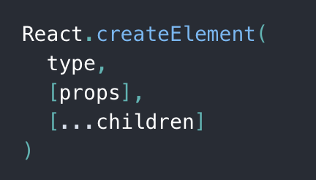
Create element
We will use React to create DOM elements !
Either a string or a React Component
Either null or an object
This is an object of HTML attributes and custom data about the element
null, a string, a React Element, or a React Component
Notes:
Props like {this.name}

Slide 18
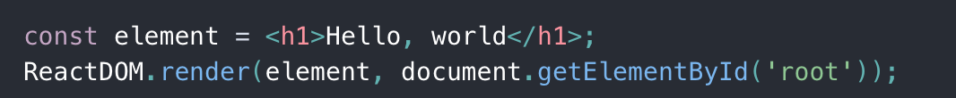
Rendering element
We used ReactDOM's render() method to render our element onto a particular area of a page.
Notes:
Element with id=root

Slide 19
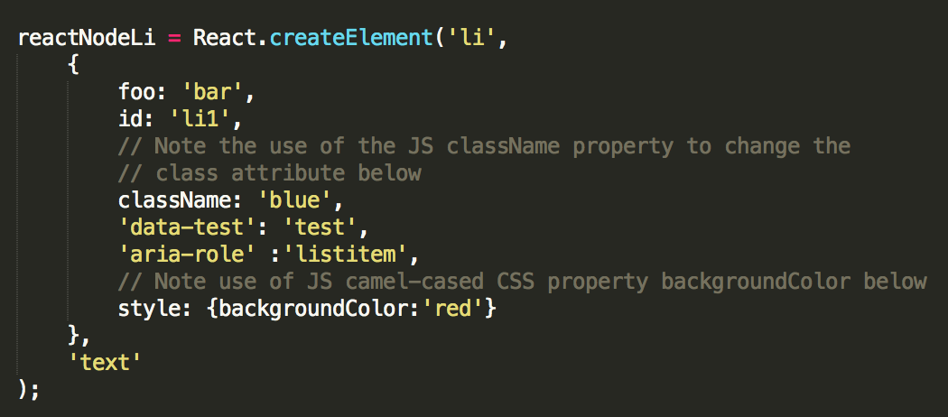
Create element attribute
Click Here
Notes:
https://reactjs.org/docs/dom-elements.html#all-supported-html-attributes

Slide 20
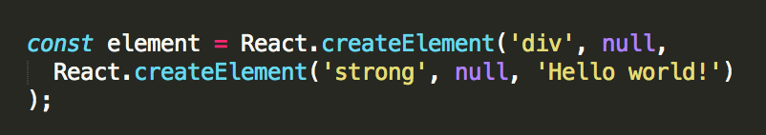
nest React elements
What will the above code return ?
Notes:
What will return ?
A single DOM element

Slide 21
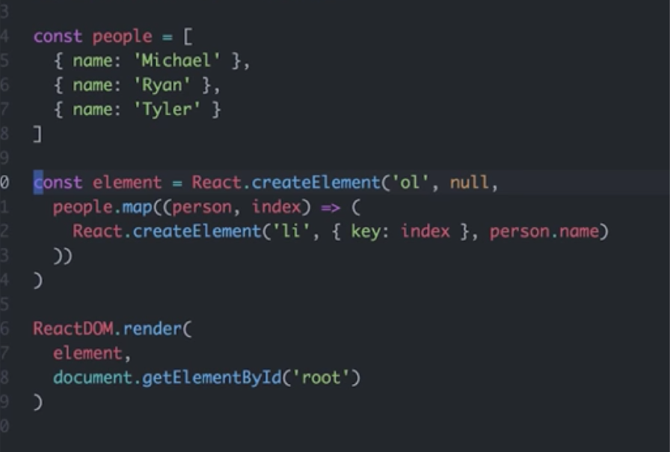
nest React elements: Map()
Notes:
What will return ?
A single DOM element

Slide 22
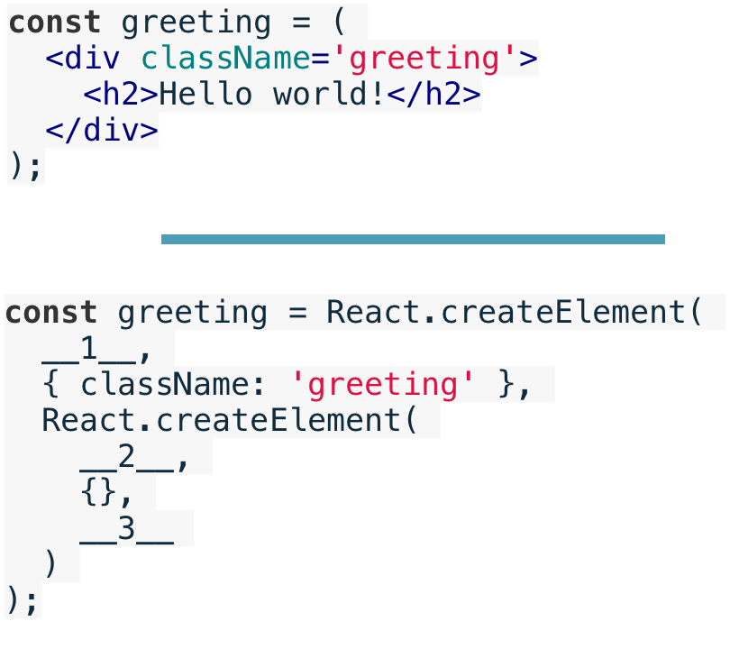
Create element exercise –blanks
Notes:
__1__ → ‘div’
__2__ → ‘h2’
__3__ → ‘Hello world !’

Slide 23

Remember that we are here to help you
All you have to do is ASK!
Thank you for Attending

